Slide 1
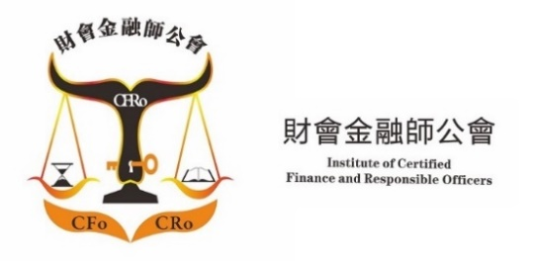
Joint Organizations 主辦機構：
The Current Situations of Hidden Champions & Unicorns in 2023
Date: 15th August, 2023 Time: 11:45 – 13:15
Supporting Organizations 協辦機構：
Sponsored by :

Slide 3
The Current Situation of Hidden Champions & Unicorns in 2023
Chester Chu

Slide 4
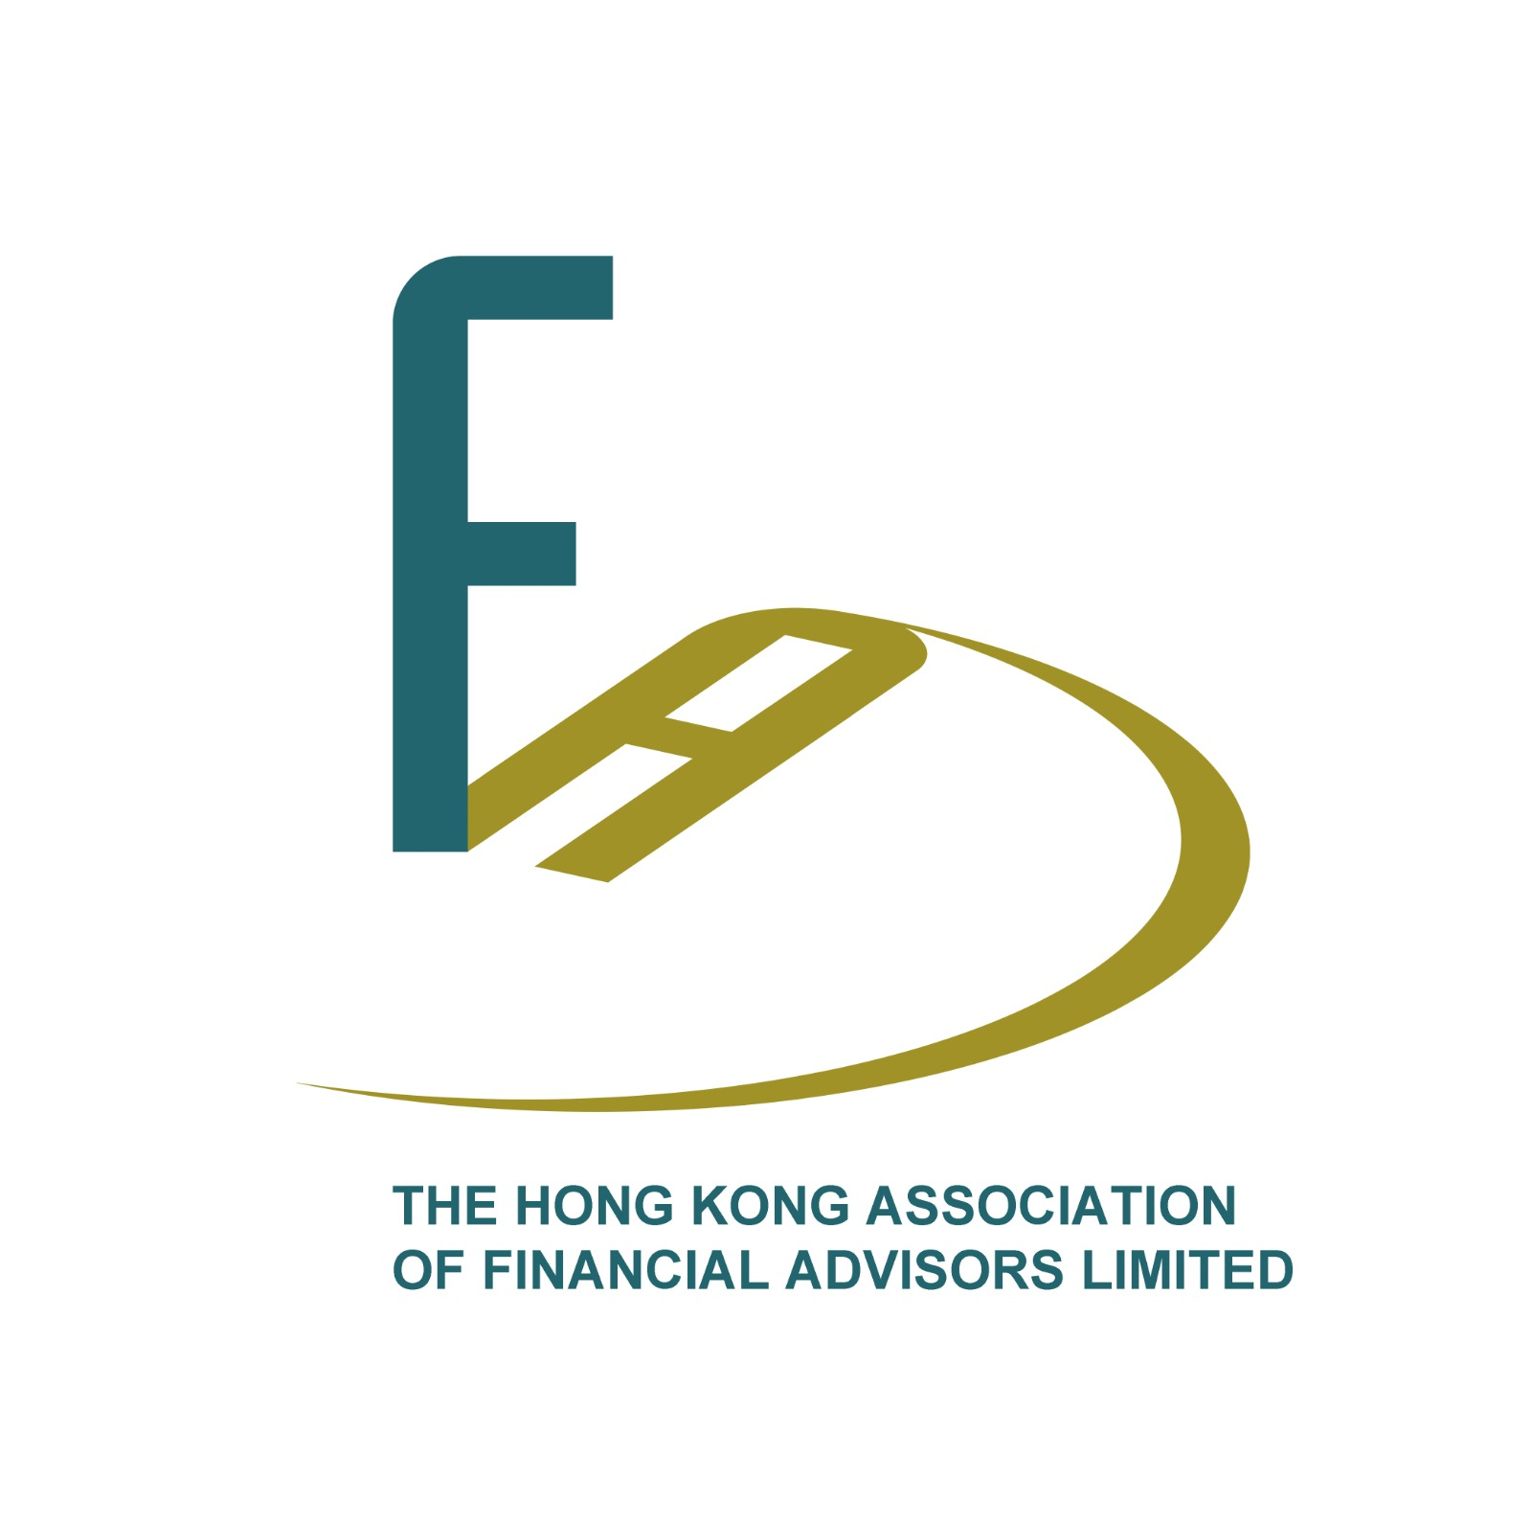
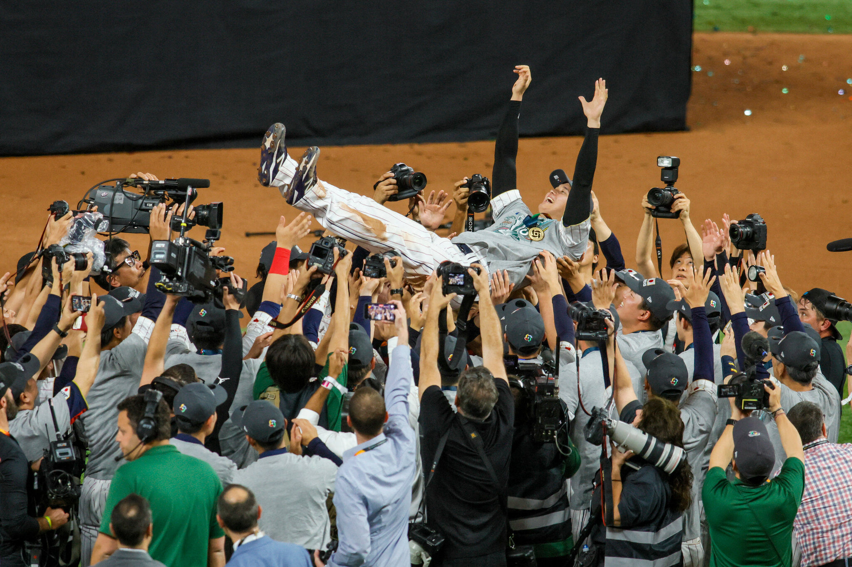
The Current Situations of Hidden Champions & Unicorns in 2023 Date: 15th Aug, 23 Time: 11:45 – 13:15 Agenda
Topic one – What is a Hidden Champion Company?
Topic two – What is a Unicorn Company?
Topic three – Hidden Champion vs Unicorn
Topic four – Questions and Answers

Slide 5
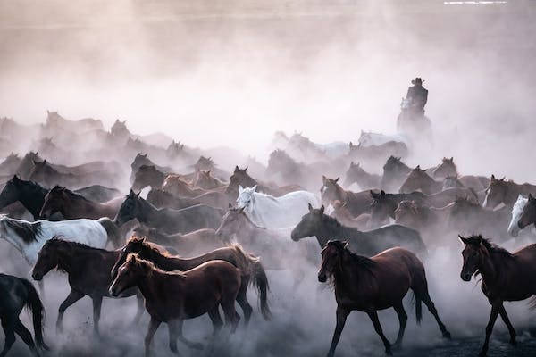
Introduction
Hidden champions are relatively small but highly successful companies that are concealed behind a curtain of inconspicuousness, invisibility, and sometimes secrecy.
The term Unicorns refers to a privately held startup company with a value of over $1 billion. It is commonly used in the venture capital industry.

Slide 6
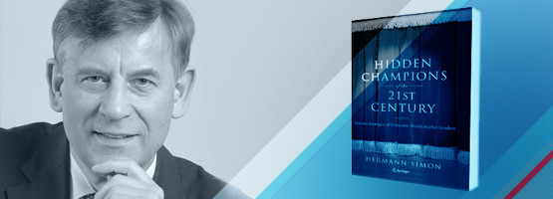
Topic one
What is a Hidden Champion Company?

Slide 7
Criteria of Hidden Champion
有很多鮮為人知的行業冠軍，他們在極端情況下生產一系列狹隘的產品 ，有時甚至祗有一種產品，持續保持領先地位，由內銷成功開始，再輸出國際，是各自行業的世界領導者，企業的成就同時造就了國家或區域經濟的獨特優勢，隱形、低調的作風是故意的，往往只有業內人士才知道它們的存在，。
西蒙教授 (Hermann Simon) 稱這類擁有行業領導地位、保持低調的成功企業為「隱形冠軍 」。
全球前三名，或區域的第一名
年收入少於40億美元
低知名度

Slide 8
Hidden Champions with world market shares of 80% or more
Company | 主要產品 | Main product | World Market Share
Dr Suwelack | 膠原蛋白 | Collagen | 100%
SkySails | 拖曳風箏輔助動力系統 | Towing kite wind Propulsion system | 100%
Gerriets | 戲院布幕與舞台布景 | Theater curtains, stage equipment | 100%
Ulvac | 液晶面板鍍膜設備 | LCD panel coating | 96%
G.W. Barth | 可可與咖啡豆加工設備 | Cocoa Processing systems | 90%
GKD - Gerbr.Kufferath | 金屬網 | Matel fabrics | 90%
Kirow Leipzig | 鐵路起重機 | Railway Cranes | 85%
Alki-Technik | 電動扭力工具 | Special crew systems | 80%
Delo | IC 卡晶片膠粘劑 | Adhesives for chip modules on smart cards | 80%
Nissha | 小型觸控螢幕 | Small touch panels | 80%
ScheBo Biotech | 體外診斷配藥生物科技 | Biotech in in-vitro diagnostics | 80%

Slide 9
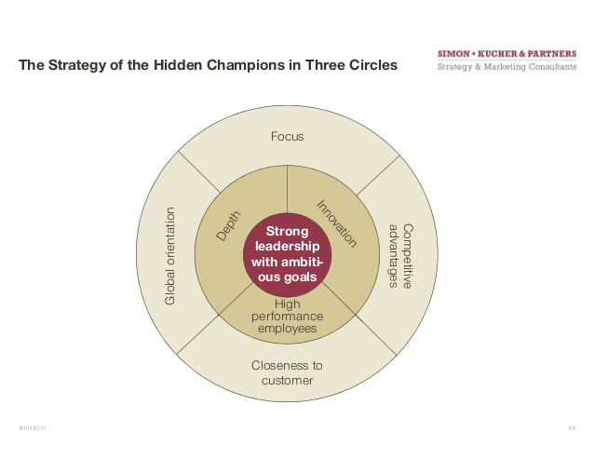
Common Points & Features
Features
Common Points
The Strategy of the Hidden Champion in 3 Circles
以工業制造產業為主，約佔69.1%
員工的安全感與企業的生存能力獲最高分，最差為成本抑減方面
專注不求大、重長期不取巧
深信「最壞的時候，也是最好的時候」，求穩不追快
平均年齡為61歲，擁有百年以上歷史的佔1/3
來自德國的佔1,307間(47.8%)，如合併瑞士、奧地利、盧森堡等德語系國家計算，共有1,540間隱形冠軍，更佔56.33%
目標、願景明確
專注
緊貼客戶
創新
全球化
深度
高效員工
分權管理

Slide 10
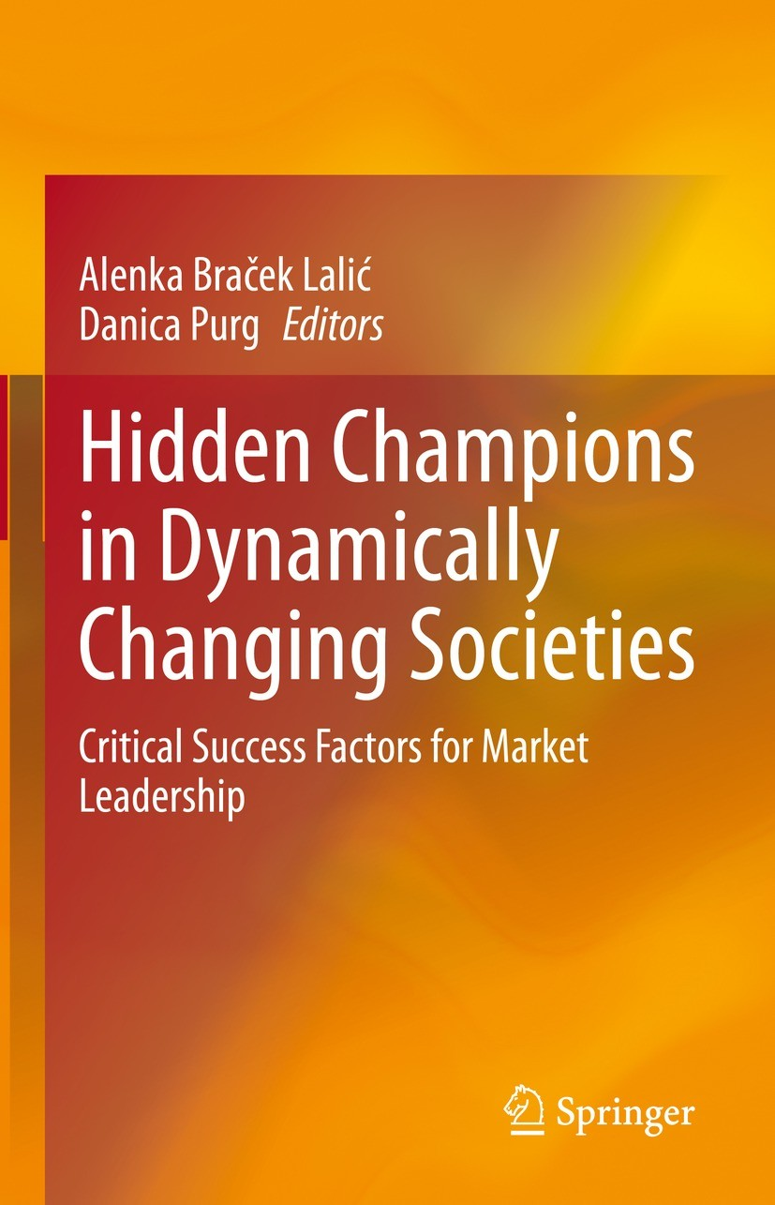
Path to Success
Countries with more than 20 hidden champions
in 2022
Model your business
Know your markets
Your Consumers, Suppliers are your partners
Diversify
Innovate
Talented Employees
Entrepreneurship
Values are never out of fashion
Adapt, Adopt, and Apply the best internal Organization
Believe in your mission
Country | No. of Hidden Champions | Per 1 million inhabitants
Germany | 1,573 | 18.91%
USA | 350 | 1.06%
Japan | 283 | 2.25%
Austria | 171 | 19.19%
Switzerland | 171 | 19.84%
France | 111 | 1.65%
Italy | 102 | 1.69%
China | 97 | 0.07%
U K | 74 | 1.11%
Netherlands | 38 | 2.17%

Slide 11
Leadership Success Factors
Notes:
Hidden Champions in Dynamically Changing Societies: Critical ..
Alenka Braček Lalić, ‎Danica Purg · 2021
Presenting the outcomes of an in-depth, multinational study on hidden champions in Central, Eastern, and Southeast Europe, Russia, China, Mongolia and Turkey, this book provides essential insights into the critical drivers of success.

Slide 12
The Mindset of Hidden Champion Leader
個人獨特的心態 Mindset
單一偏執狂 Monomania , Unity of Person & Purpose
與別不同的靈感 Inspiration & Inspiration of others
勇於冒險 Fearlessness, Courage to Take Risks
有耐力和毅力，逆流而上 Stamina & Perseverance
Swimming Against the Current
長期展望 Long-Term Perspectives
(Zitelmann, 2019)
Notes:
These are the founders and owners of massively successful companies, exceptional individuals such as Steve Jobs, Bill Gates, Jeff Bezos and Mark Zuckerberg.
Monomania - While the CEOs of large corporations remain loyal to their companies for an average of just six years, the leadership continuity of hidden champions is much stronger, with leaders staying at the helm for 20 years or more

Slide 13
The way to get started is to quit talking and begin doing.
Walt Disney

Slide 14
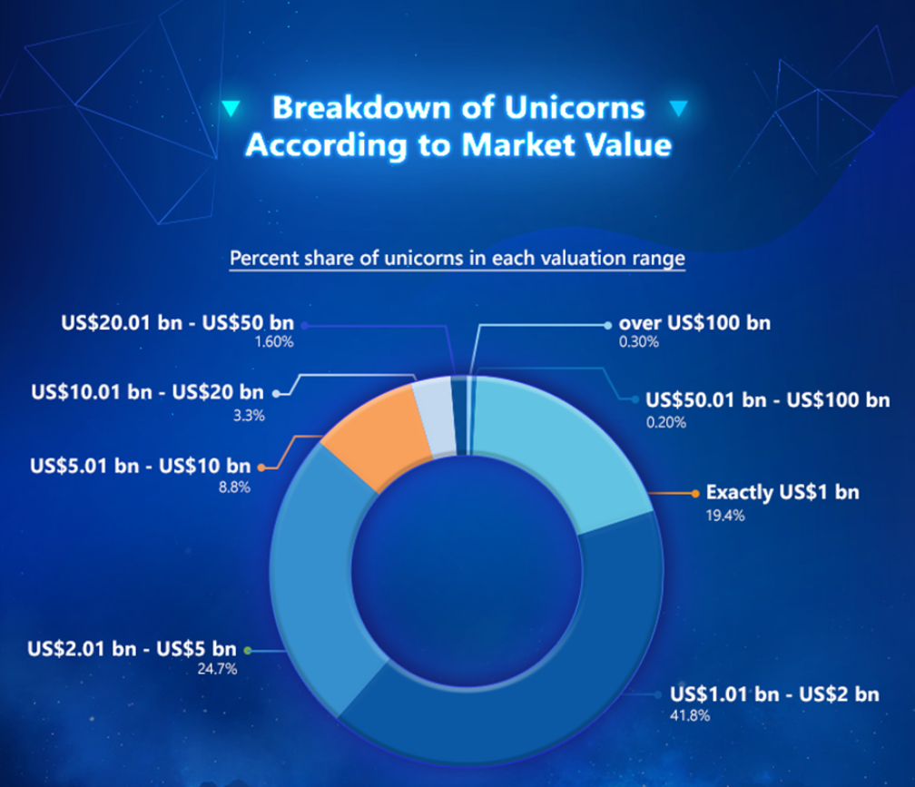
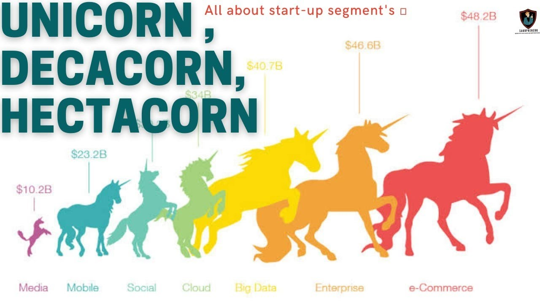
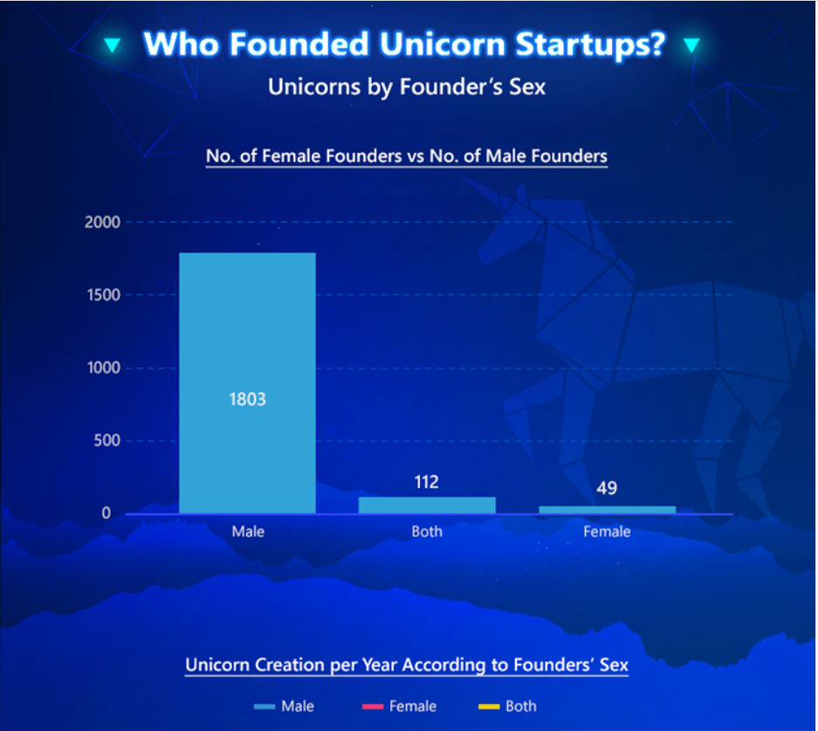
Topic two
What is a Unicorn Company?
Notes:
Decacorn: valuation over 10 Billion, Hectacorn: valuation over 100 billion

Slide 15
What is a Unicorn Company?
美藉華裔創投人艾琳‧李（Aileen Lee）描述的初創企業。
估值10億美元的公司。US$1B+
Crunch Base資料庫將獨角獸公司分為三類：分別是獨角獸類、已被併購類和已IPO成功上巿類。
科技初創公司創新的概念已發展至不止於偉大的發明、產品，最重要是商業模式，肩負改變世界的重任，創投人會出資幫助獨角獸快速擴張，以快為主，不必獲利，變大就對了。
美國在2003至2013的過去10年，誕生了39 隻獨角獸， 平均每年４隻，成功率小於萬分之一(0.07%)。
Number of Unicorns worldwide 2023: 1,219
Total Cumulative Valuation: US$3,823 Billion

Slide 16
What makes a Unicorn?
Recent creation: Unicorns are emerging businesses that exploit a small or unknown market niche and achieve a value of over 1 billion dollars. Their workforce is also a sign of their “youth”, with employees being, on average, 30 and 40 years of age.
Innovation: New technology is a basic business feature of unicorns operations and communication more efficient. They often use social media to gain recognition.
Scalability: Unicorns scale up and boost their returns quickly while keeping costs low.
Financing: Unicorns are adept at attracting investors and maintaining private equity, without being publicly listed.
Business model: Unicorns’ strategies target end consumers with a disruptive alternative that meets their needs. Not only do they focus on their product, but also on customer satisfaction.
Source: Santandar Group City(SGC)

Slide 17
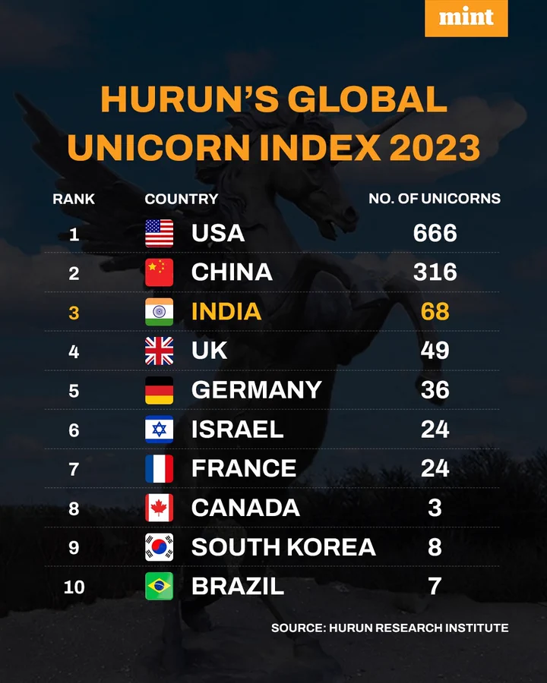
Number of Unicorn Companies in 2023
Notes:
World's Top 10 most valuable unicorns* in 2023:
5 are from China -- ByteDance , Ant Group, Shein, WeBank and Cainiao.

Slide 18
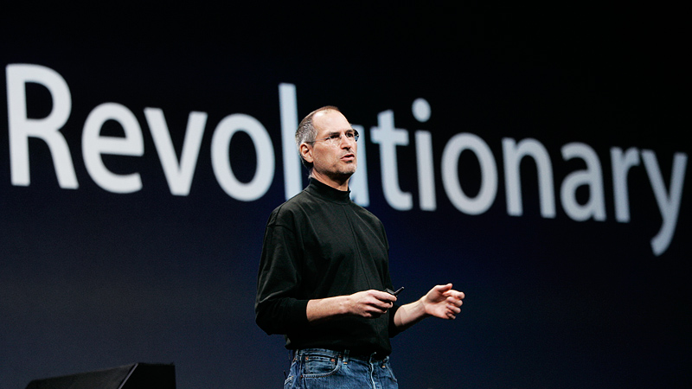
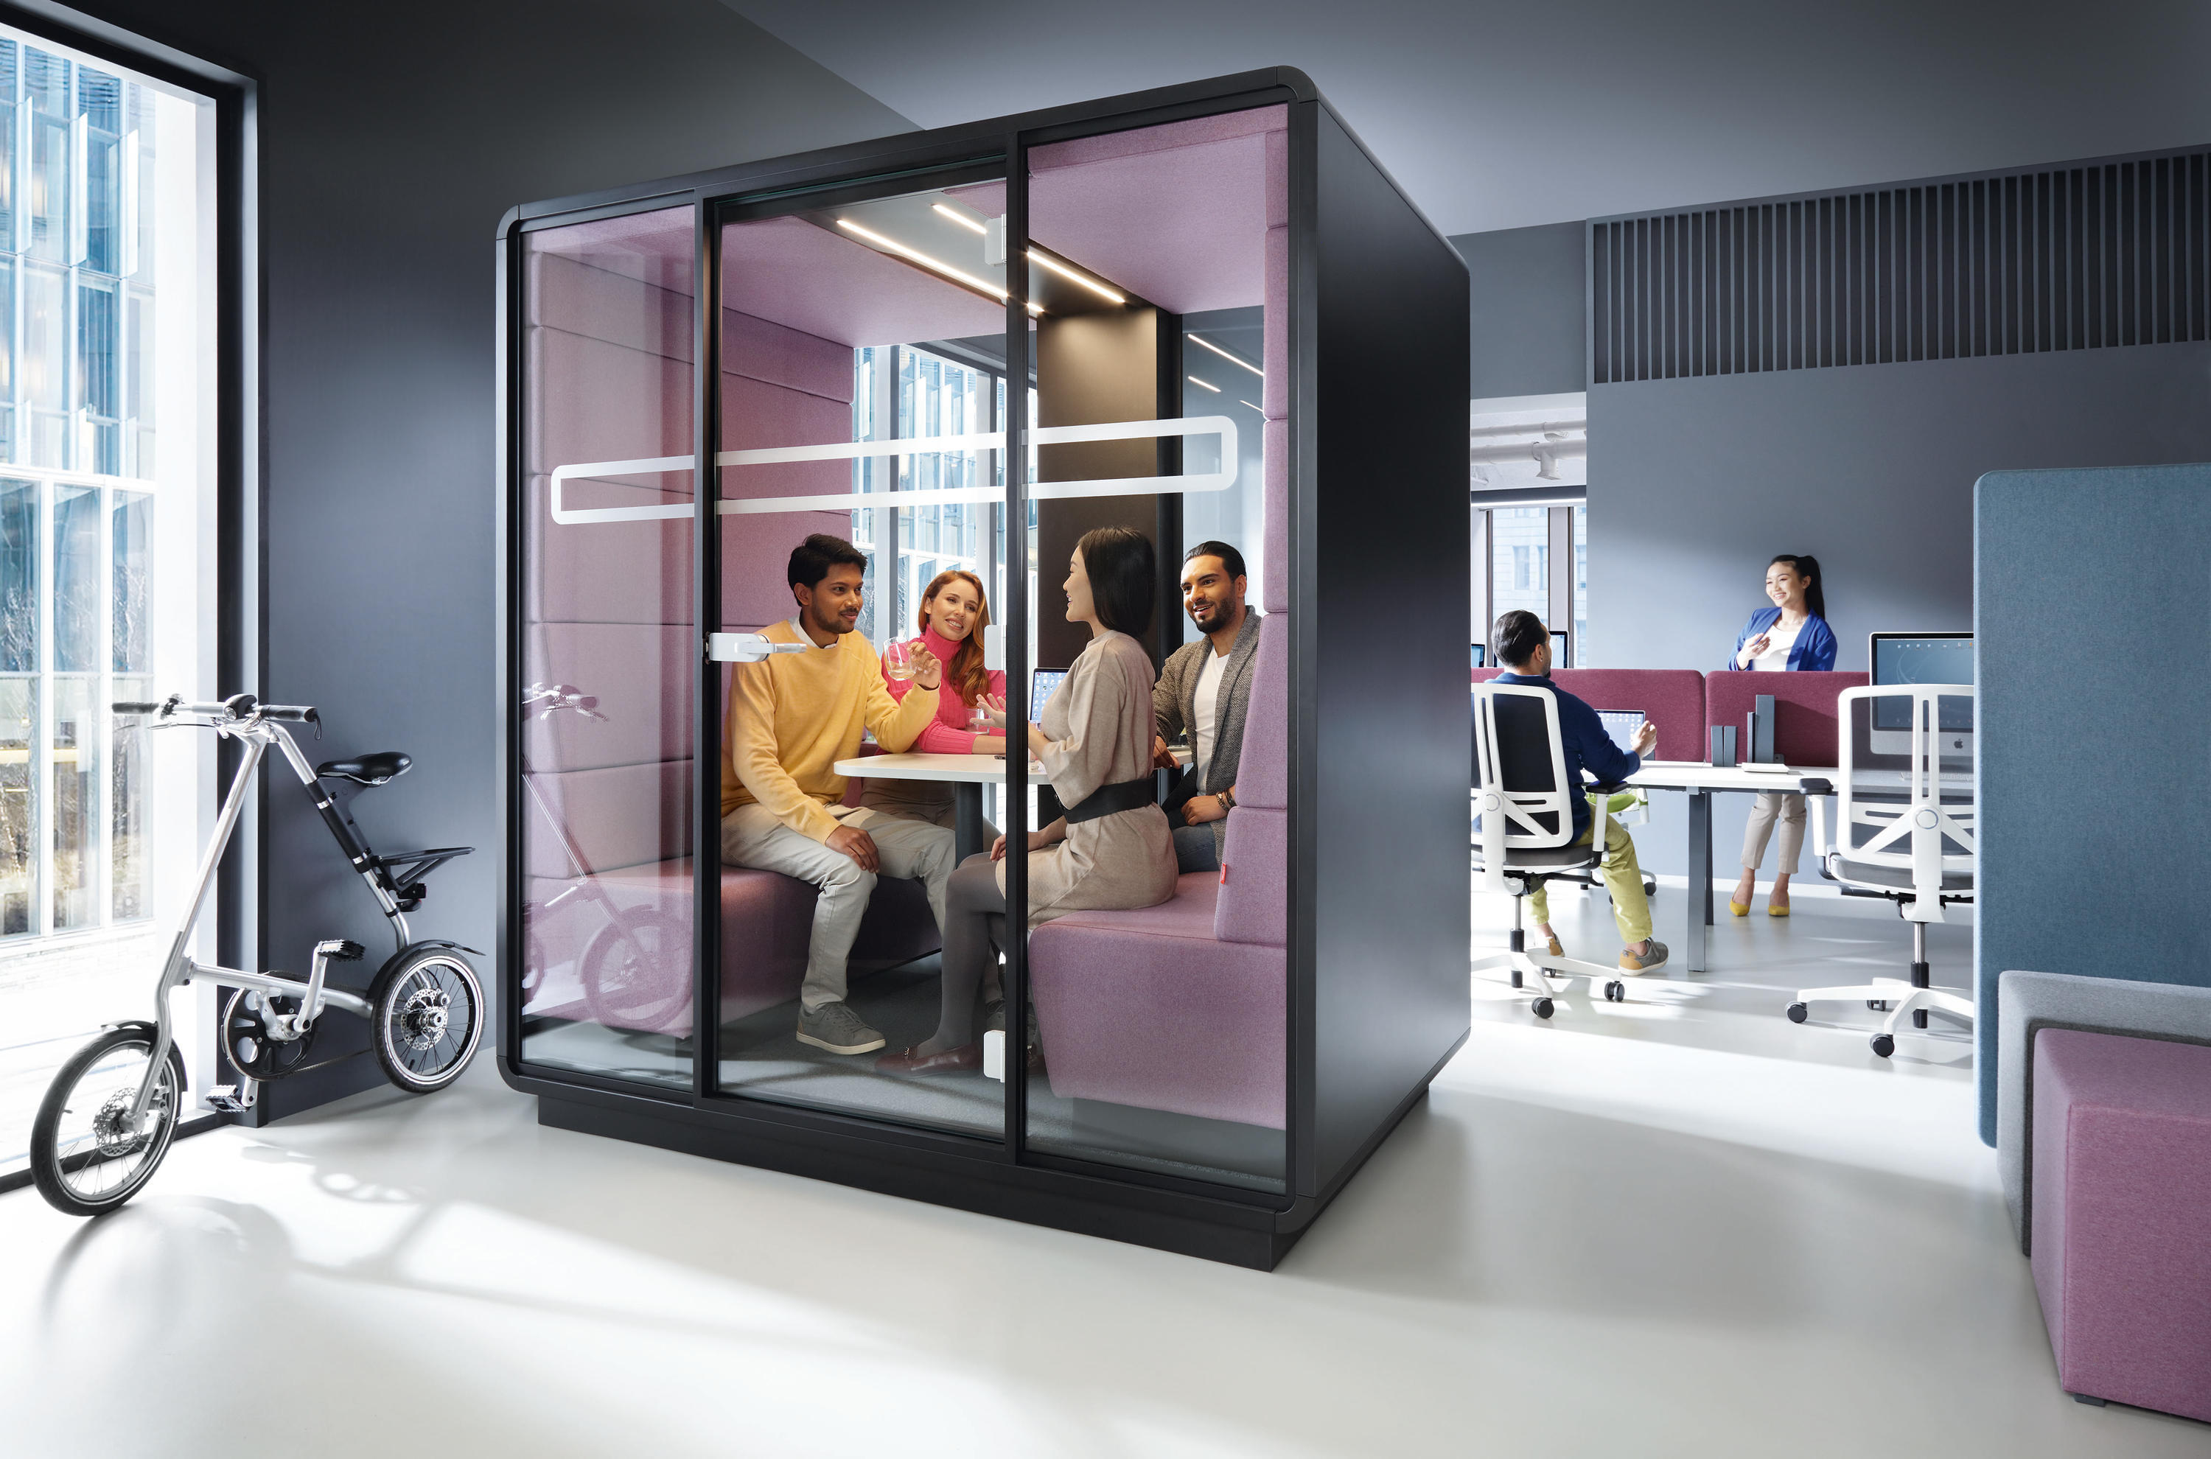
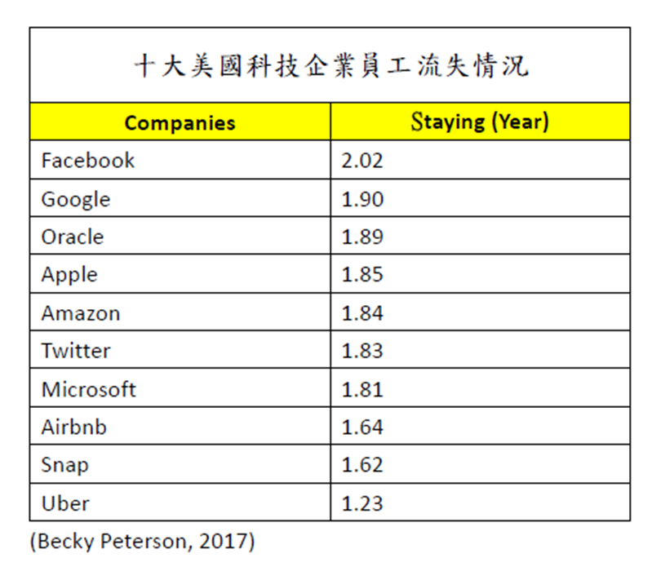
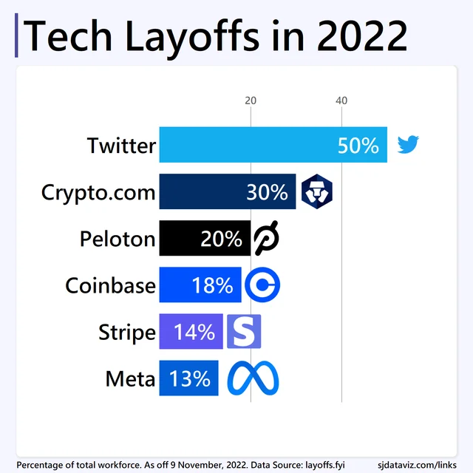
Typical weakness of Unicorn
輕管理、重包裝、重形輕實
資金容易流失和缺乏持續發展能力
培養區的狂妄、傲慢的瘋狂世界
籌募資金能力和美麗的誤會
獨角獸教主和信眾的關係
年青人和廉價勞工文化
誰是最大得益者

Slide 19
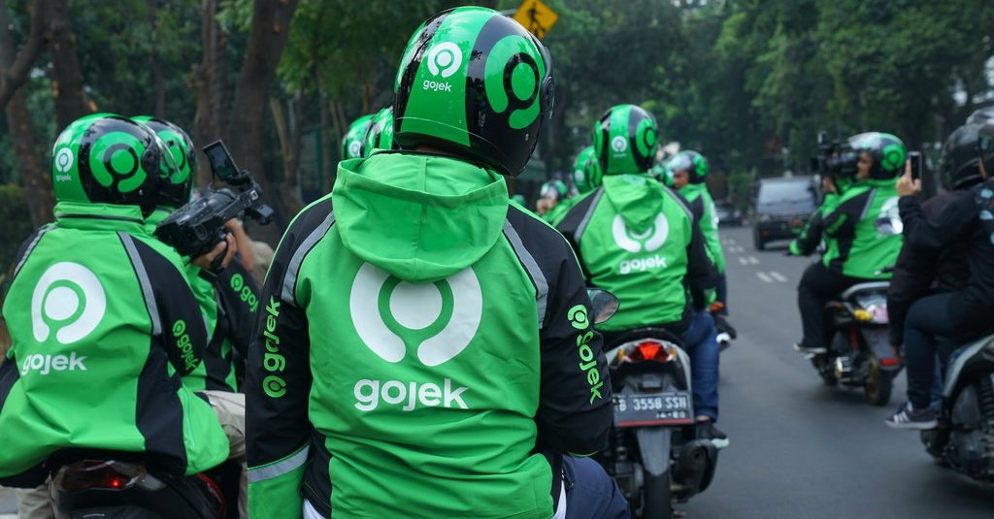
Topic three
Hidden Champion vs Unicorn

Slide 20
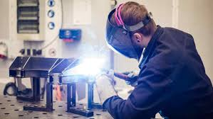
Hidden Champion vs Unicorn
 | 獨角獸 | 隱形冠軍
出身地 | 英美偏好獨角獸 | 以德國為首的歐洲則較多隱形冠軍
投資者 | 初創投資者、天使基金、風險資本 | 長線投資者、傳統基金
資金來源 | 上市集資、上市前集資、投資銀行 | 銀行借貸、資本、盈利增值
人力資源 | 低工資、股權獎勵、高流失率 | 重視員工滿意度、低流失率、人才培訓
行業 | 顛覆傳統行業、創新、金融服務為主 | 工業產品較多、精益求精
競爭優勢 | 低銷售價、低成本、規模效應 | 有定價能力、質優量小、競合競爭
策略 | 製造創新服務、外包、低成本、稅地生產 | 自己設計、自己生產、自己銷售
發展新市場 | 複製、模仿成功案例 | 以收購為主
領導人 | 崇倘個人魅力 | 穩打穩紮、長遠目標為主
估值 | 以預期未來收入和市佔率為主 | 重視企業盈利、資產淨值、派息比率、市盈率等
增長要求 | 增長快、風險高 取其回報期短和回報率高 | 要經過長時間培育和成長，追求的是市場領先地位
Notes:
企業估值方面，獨角獸以預期未來收入和市佔率為主，博傻理論(greater-fool theory) (Lahart, 2019)，適宜於國泰民安和市場資金充足之時；隱形冠軍則以傳統估值方法，重視企業盈利、資產淨值、派息比率、市盈率等，逆境出現，是更上一層樓之時。

Slide 21
Number of Unicorns & Hidden Champions Source: CB Insight
Unicorn Companies Country | No. of Unicorn Companies | %
USA | 656 | 60.68%
China | 172 | 15.91%
India | 70 | 6.47%
U K | 52 | 4.81%
Germany | 30 | 2.78%
France | 25 | 2.31%
Israel | 24 | 2.22%
Canada | 21 | 1.94%
Brazil | 16 | 1.48%
Singapore | 15 | 1.38%
Total | 1,081
Hidden Champions Country | No. of Hidden Champions | Per 1 million inhabitants
Germany | 1,573 | 18.91%
USA | 350 | 1.06%
Japan | 283 | 2.25%
Austria | 171 | 19.19%
Switzerland | 171 | 19.84%
France | 111 | 1.65%
Italy | 102 | 1.69%
China | 97 | 0.07%
U K | 74 | 1.11%
Netherlands | 38 | 2.17%
Total | 2,970

Slide 22
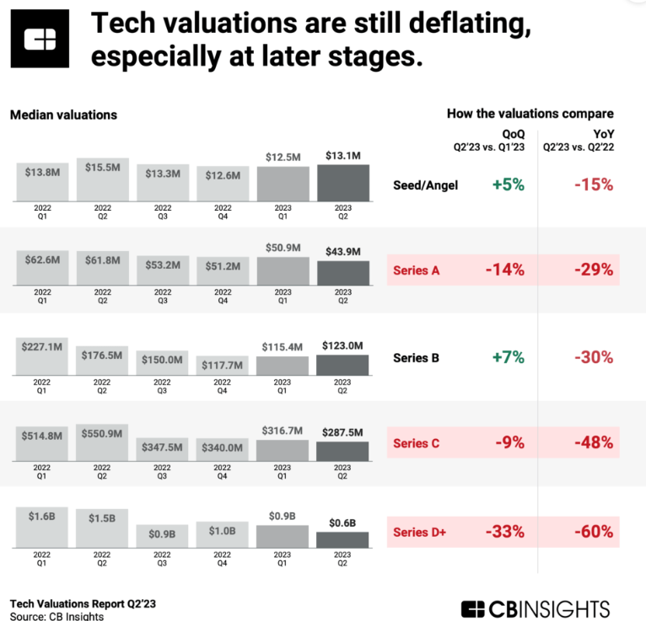
Valuation
The World’s Most Valuable Unicorns 2023
Spinger’s Comments for H.C. Valuation
Company | Valuation (US$bn) | Country
ByteDance | 200 | China
SpaceX | 137 | USA
Ant Group | 120 | China
Shein | 65 | China
Stripe | 50 | USA
WeBank | 33 | China
Databricks | 31 | USA
Telegram | 30 | Dubai
Revolut | 28 | UK
Cainiao | 27 | China
Hidden champions are market leaders in niche markets and are an important part of the German Mittelstand. Although the hidden champion phenomenon has received considerable interest in practice, few academic studies on this issue exist. We especially lack evidence on the financial performance of hidden champions. Our study addresses this gap and investigates the profitability of hidden champions. In analyzing a panel dataset of 4677 German manufacturing firms, of which 617 are hidden champions, we find that hidden champions have significantly higher profitability with regard to return on assets but less so regarding return on equity. The hidden champion performance effect on return on assets is valued at 1.7 percentage points. Furthermore, the hidden champion performance effect decreases with firm size. Our paper contributes to the literature on the effect of firm strategy on firm profitability and adds to a better understanding of the hidden champion phenomenon.

Slide 23
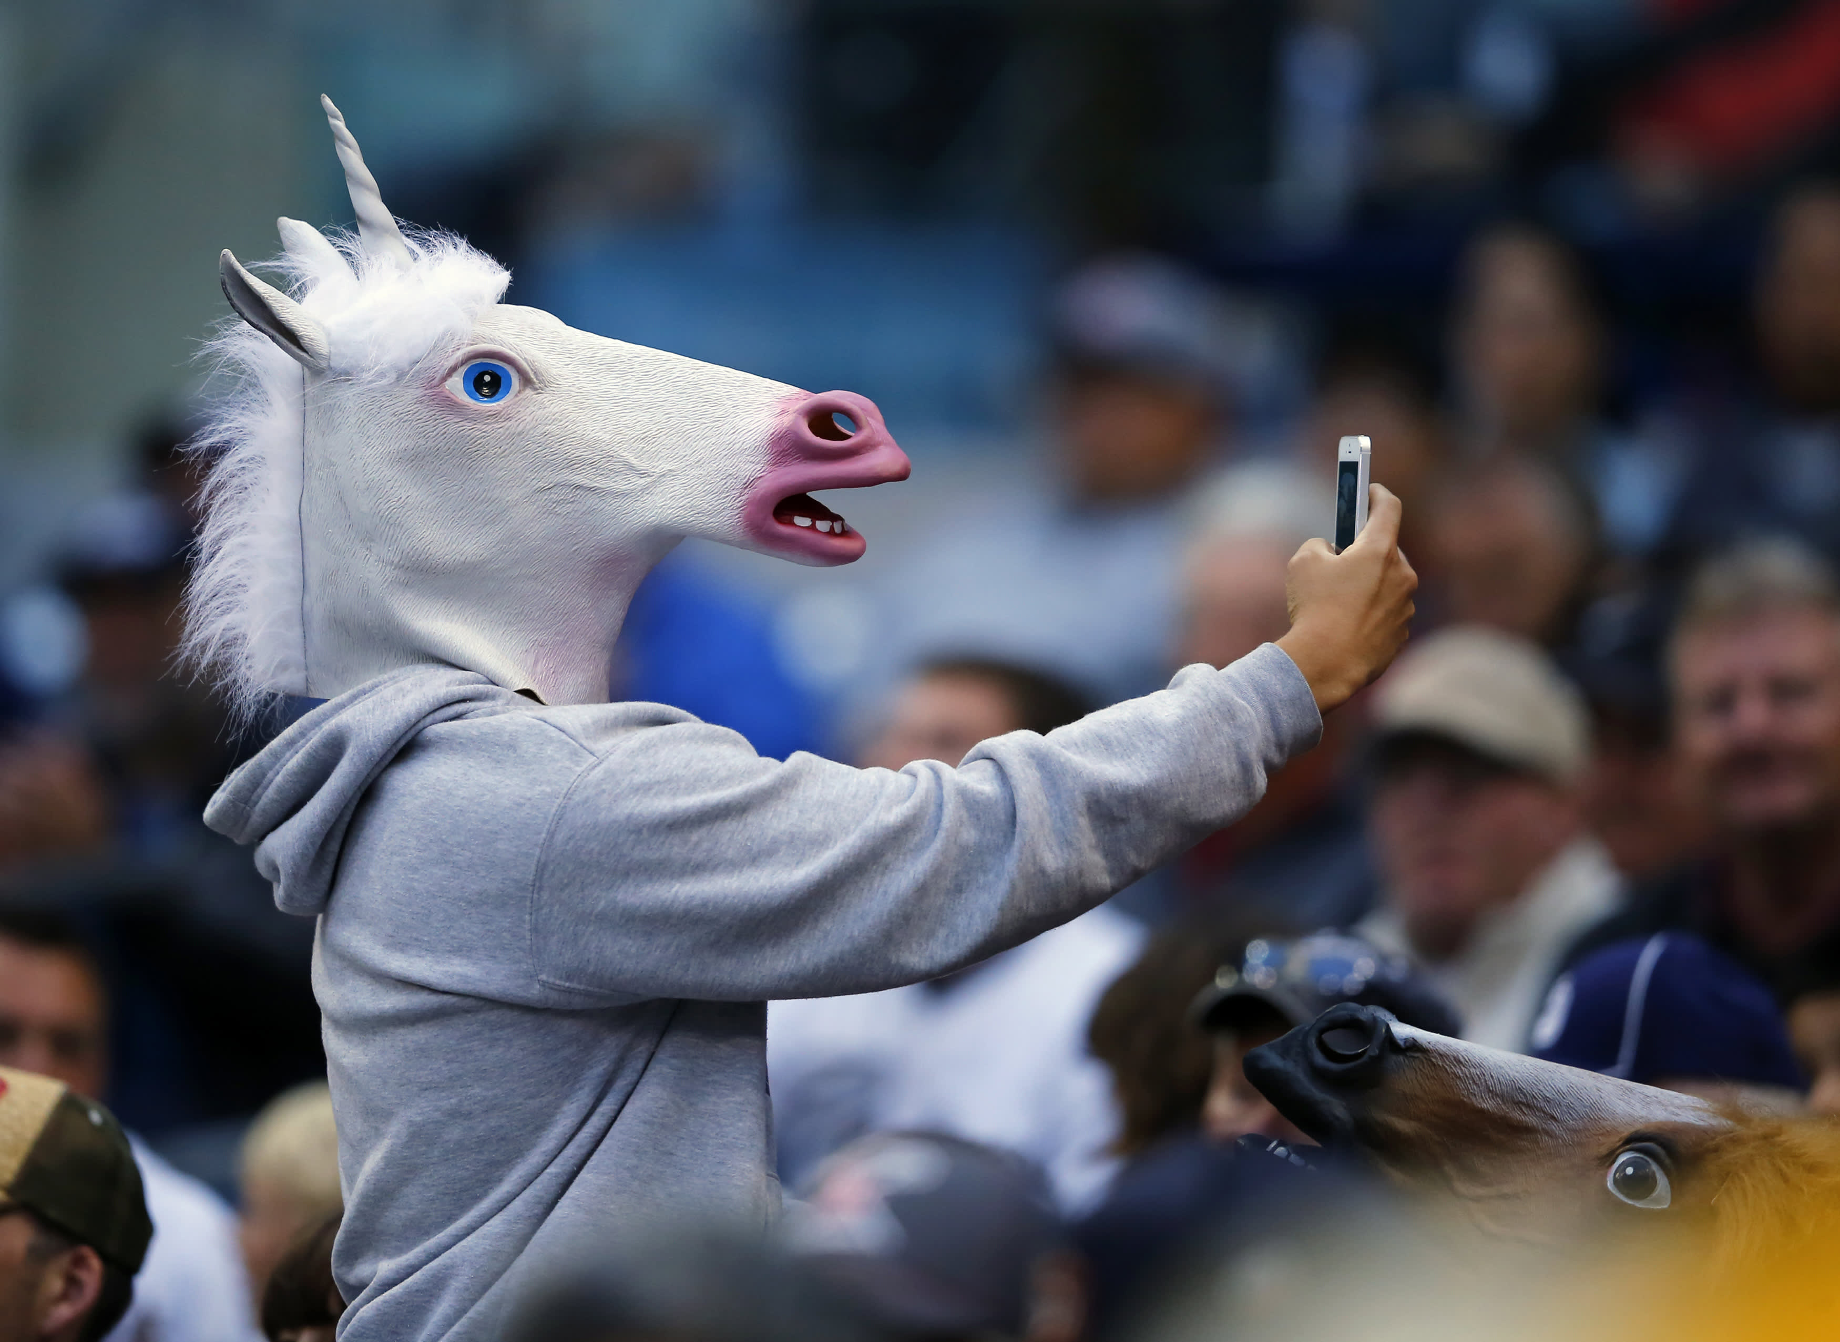
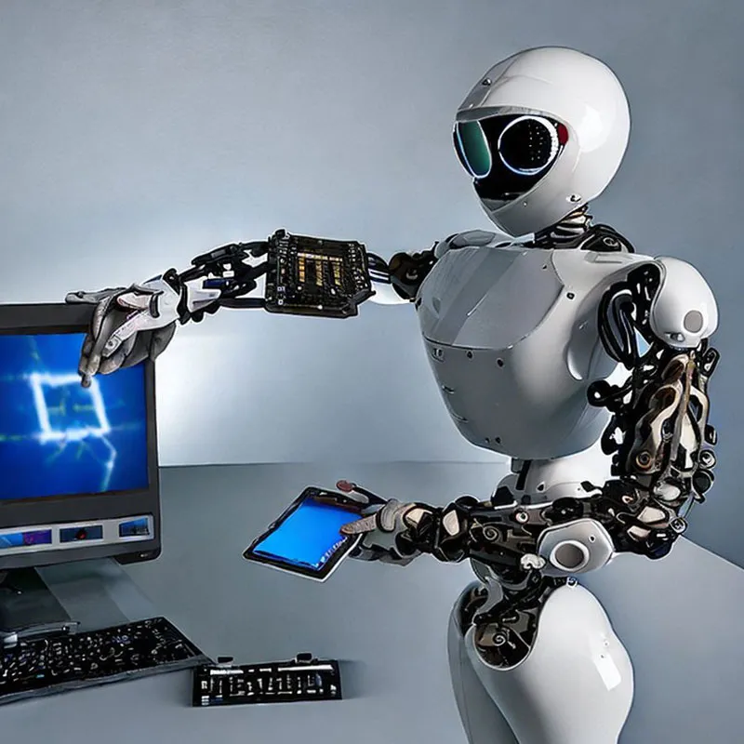
Summary
通脹壓力、利率走勢、地緣政治、經濟冷卻和極端天氣下 ，感覺2023 年的經濟前景更加不穩定， 也迫使政府長期保持緊縮政策。追求增長快、回報期短和回報率高的Unicorn 投資者，已慢慢地減少投資，而抗跌力強的Hidden Champion正好把握擴大市佔率的黃金機會。行業以科技、醫療健康、能源基建為主。
科技的破壞性創造，如人工智能(AI) 的數字顛覆，有危有機。ESG的出現，持續發展的能力，全球關注，金融體系向低碳經濟轉型，都是投資的新機遇。「心理定向」（psychological targeting）引發數據管理道德關注，以免被偽命題引發意想不到的危機。

Slide 24
Reference
Books & Journals
HAE-YONG, S. (2014). Hidden champions’ are revealed. Korea JoongAng Daily.
Hidden Champions Capital Management. (2020, July). Insights - Newsletter. 01 Jul HCF Newsletter- June 2020 Updates: Portfolio Overview & Our Investment Updates.
Simon, H. (2009). Hidden Champions of the Twenty-First Century. Germany: Springer.
Zitelmann, R. (2019, July 15). The Leadership Secrets Of The Hidden Champions. Forbes.
朱維鵬. (2020, ６月). 21世紀的隱形冠軍. 中外要聞, pp. 16 - 20.
吳宥忠. (2019). 《投資＆創業の白皮書》：一半的獨角獸，其實是灌了非常多水的獨角仙. China: Chuang Jian wen Hua chu ban, 2019.
Simon Kucher & Partners. (2014, May 23). Hidden Champions The Vanguard of Globalia. Retrieved from https://www.slideshare.net/GregorioLato/simon-kucher-hermannsimonhiddenchampions
Xinhua News. (2019, 10 17). Germany's hidden champions meet China in Heidelberg. Retrieved from www.news.cn: http://www.xinhuanet.com/english/europe/2019-10/17/c_138477447.htm
彭劍鋒. (2020, 1 14). 隐形冠军和独角兽的区别. Retrieved from 億歐: https://www.iyiou.com/p/122073.html
Dan Lyons, 2017. Disrupted, My Misadventure in the Start-Up Bubble.
Cruch Base, 2023. Valuation of Unicorn.
Hurun Research Insitute, 2022. Walkthe Chat Analysis.
Chester Chu & Dr Perry Ip, 2018. 中外要聞, Page 20,疑似獨角獸的企業

Slide 25
Thank you
Presenter
DR Chester Chu
Email chester@hkafa.org
Website
www.hkafa.org

